Slide 1
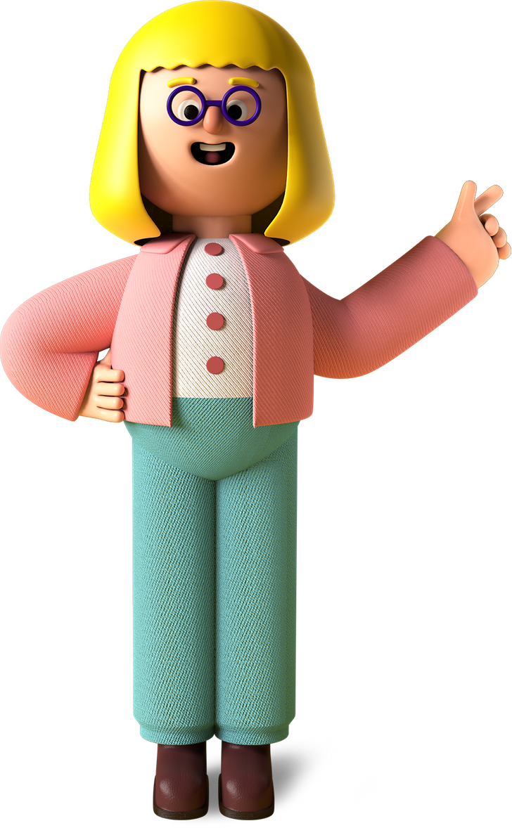
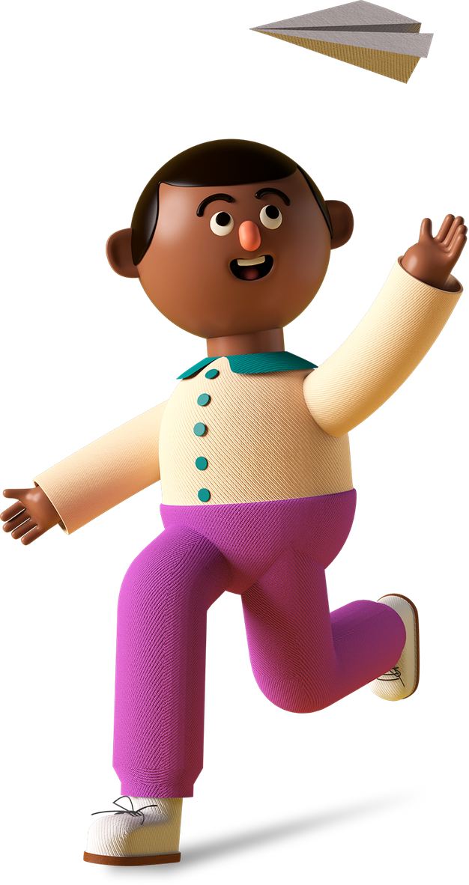

Student
Project

Slide 2

Project Name

Slide 3
Project Link

Slide 4

My favorite part about the project

Slide 5

What I learned from it
01
02
03

Slide 6
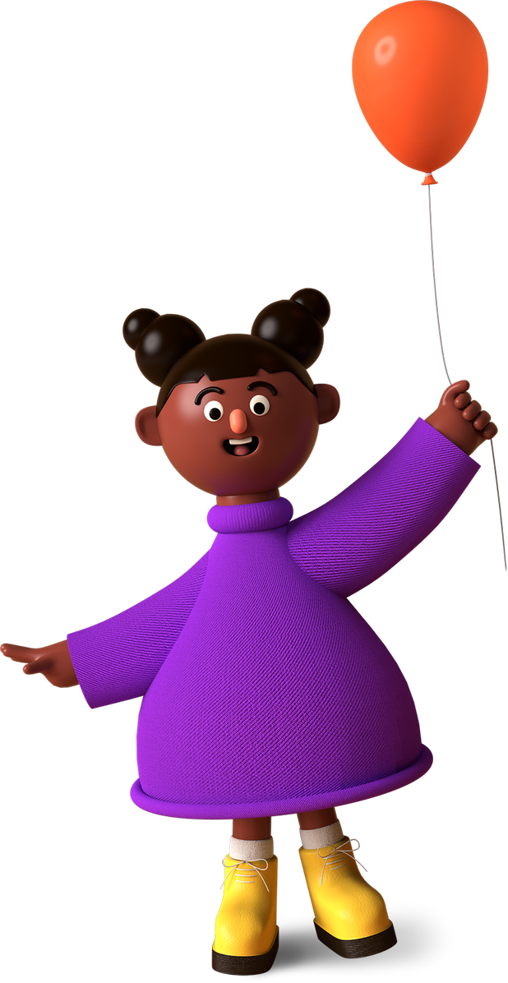
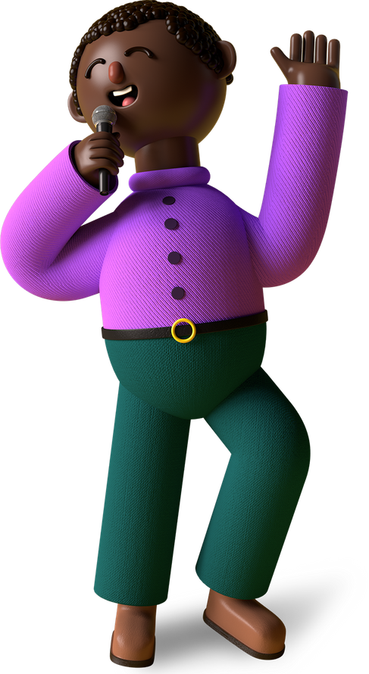
Thank You, Merry X’Mas & A Happy New Year From (Student Name),
A Young Coder In The Making!

